Slide 1
Journey Presentation WEEK 4
Anisha Gupta (Batch- 4)

Slide 2
CUSTOM BOOTCAMP

Slide 3

DAY 5: 04-09-2023
Azure data factory is cloud based ETL(extract, transform, load) service that allows us to create data-driven pipelines for orchestrating data movement and transforming data at scale.
Performed a group activity : Work with Azure Storage to explore redundancy options and storage tiers. You will start by creating an Azure Storage account and gaining an understanding of the available redundancy options, such as LRS, ZRS, GRS, and RA-GRS.
Successfully created Azure Storage Blob and dataset, Azure Data Lake storage, Queues, Fileshare, Table.
Hosted a static website.

Slide 4
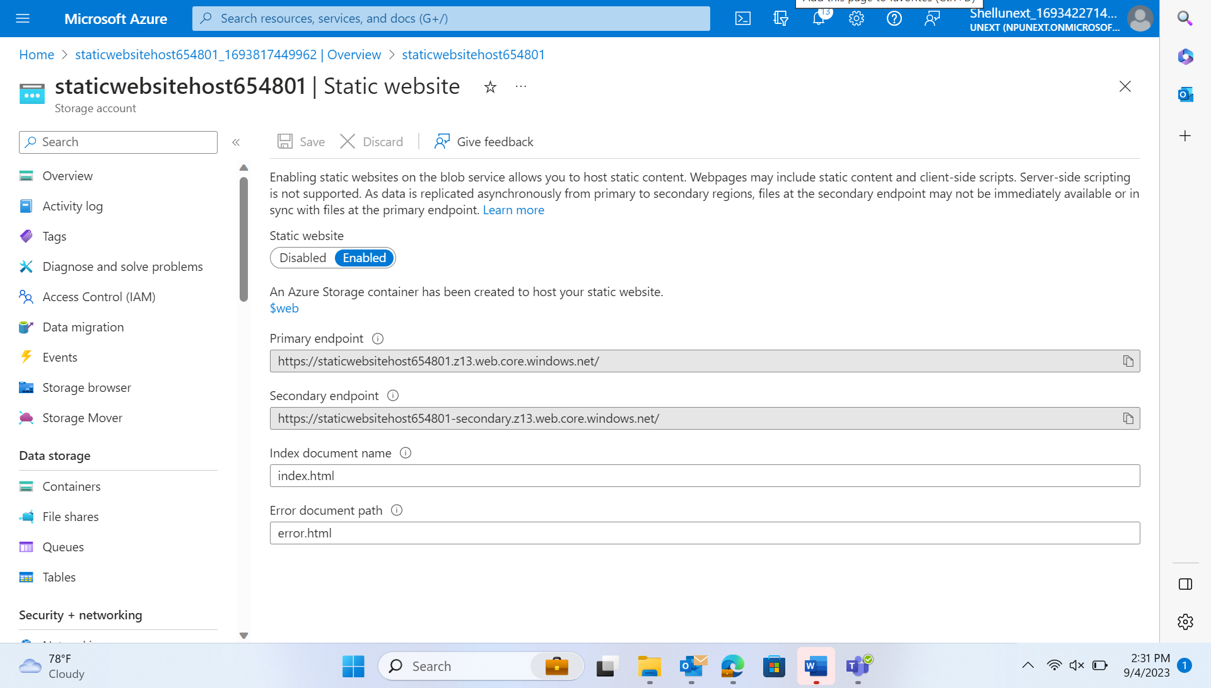
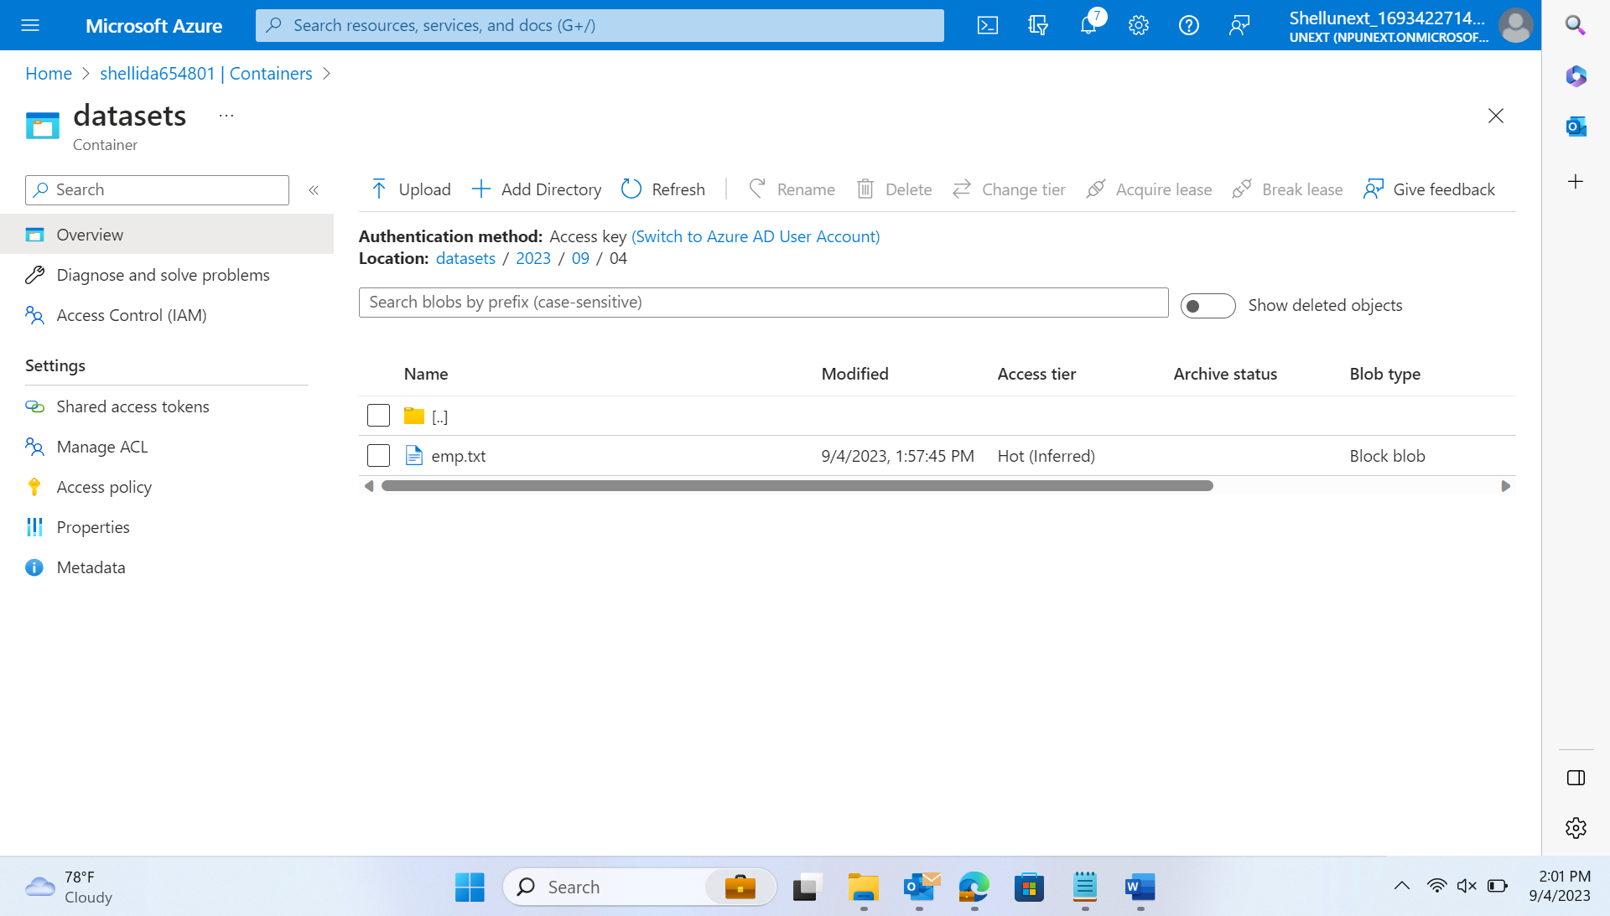
Created a static website
Created a blob and added dataset inside its container

Slide 5
DAY 6: 05-09-2023
SSIS – SQL Server Integration Service
SSAS – SQL Server Analytical Service
SSRS – SQL Server Reporting Service
Designed Pipelines
Activity: Copy data from Source(Blob) to Destination(Data Lake)

Slide 6
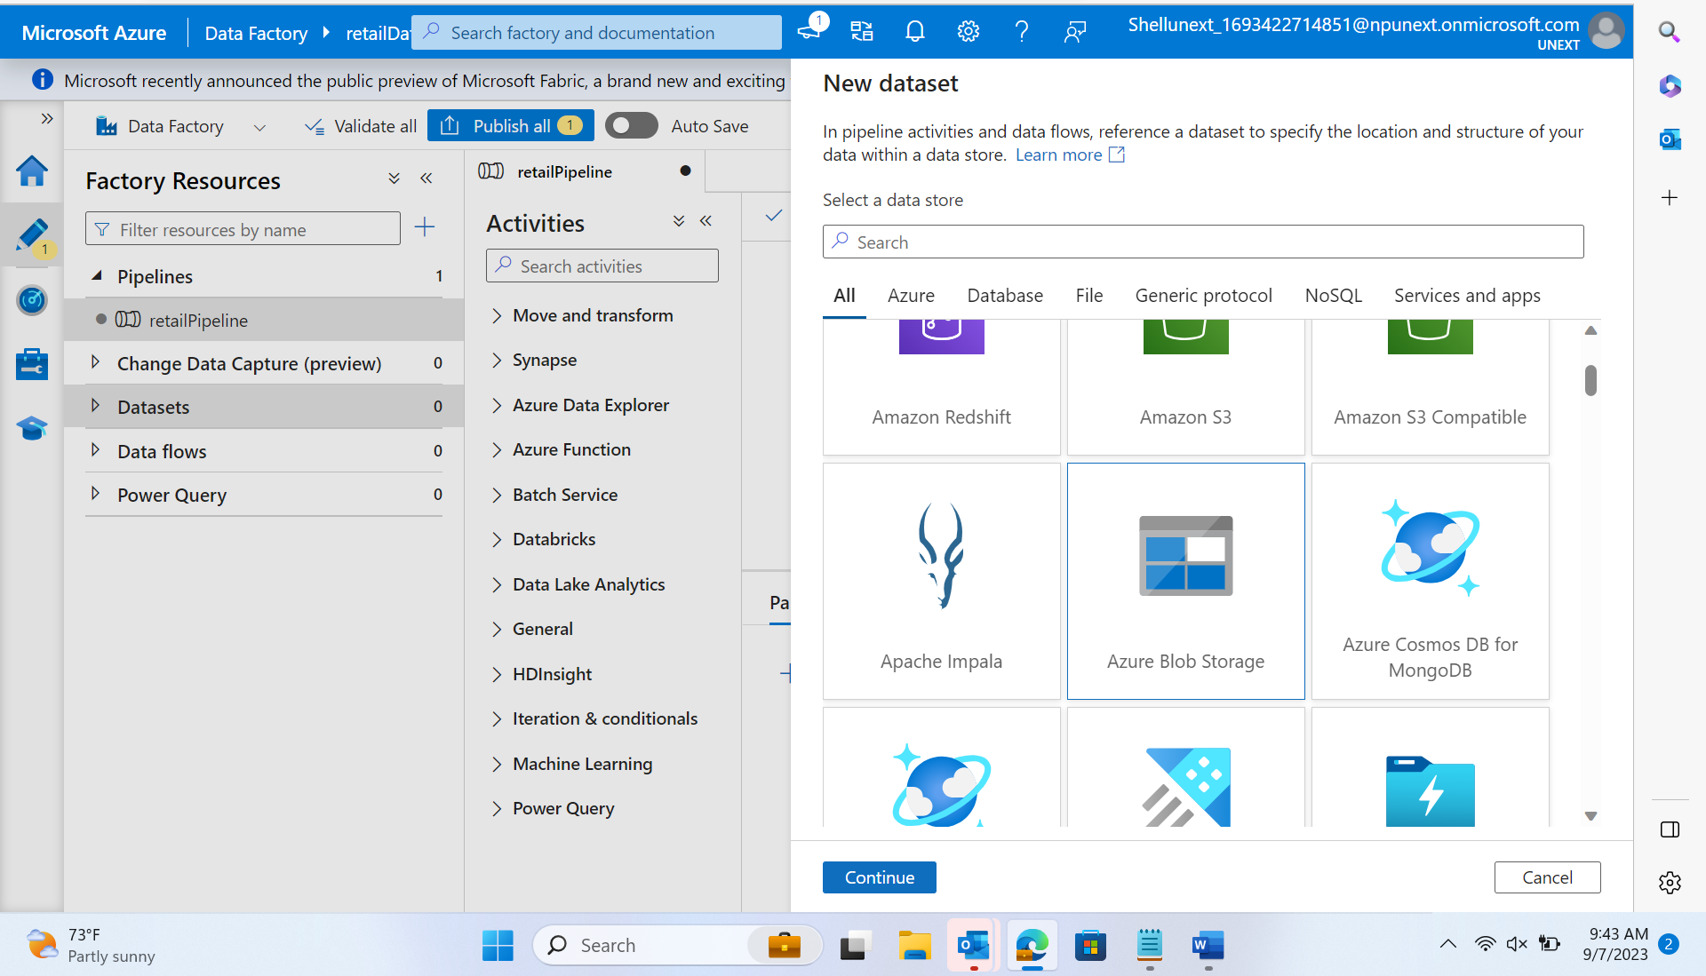
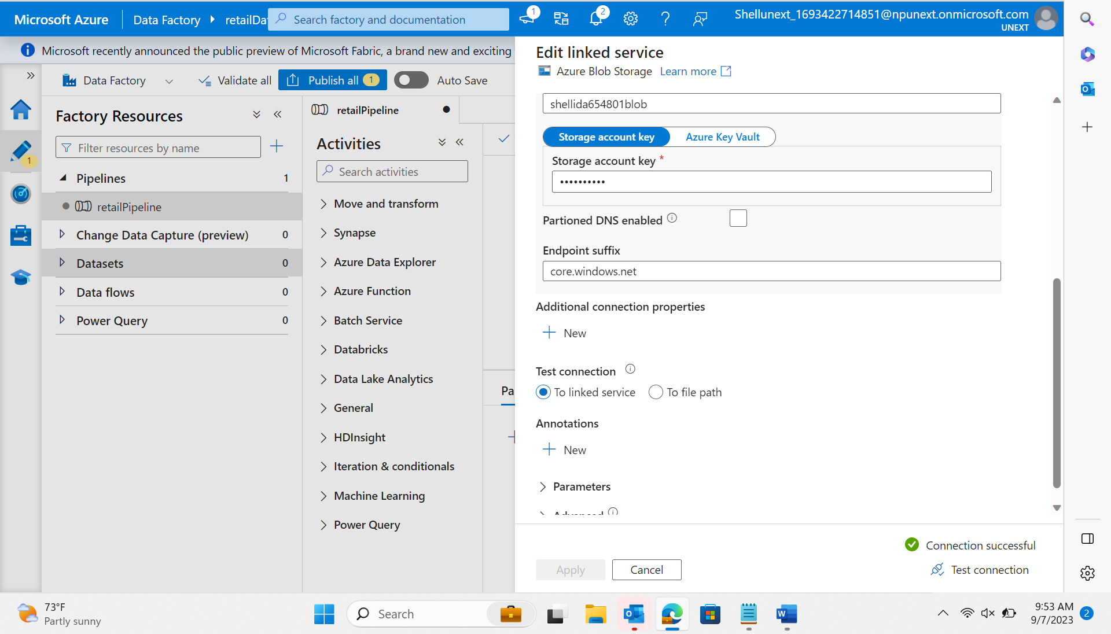
Add dataset from the source/ to the sink
Adding linked service

Slide 7
DAY 7: 06-09-2023
Control flow:
Copy data: blob is source to sink ADLs
Get Metadata -> file -> size, columns, child items
Triggers -> schedule, tumbling window, storage, event
Monitoring
Debug
Get metadata, Filter → control flow filter → takes array as input from other activity
Dataflow → source, sink, and filter transformation on nation key.

Slide 8
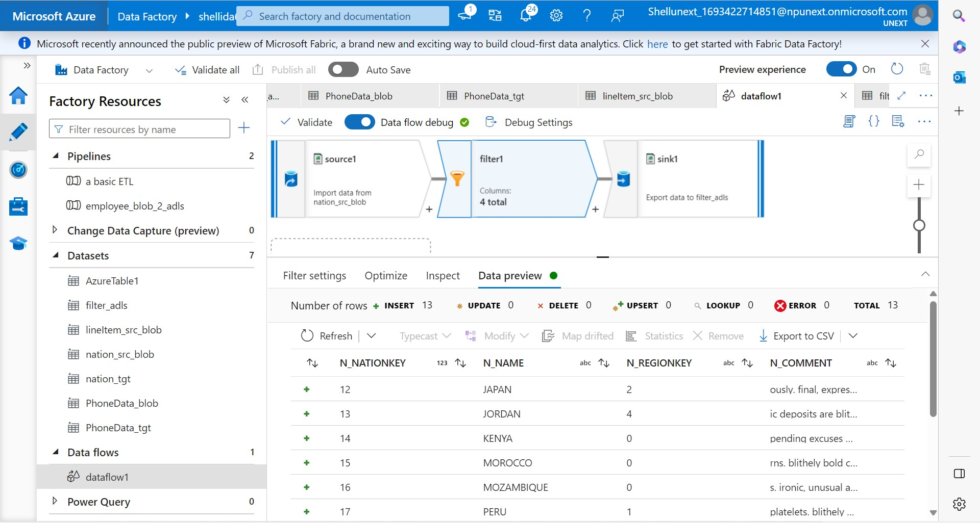

Slide 9
DAY 8: 07-09-2023
Control Flow:
For each
if
wait
set variables
append variables
Data Flow:
Derived columns
filter
join
union
conditional split

Slide 10
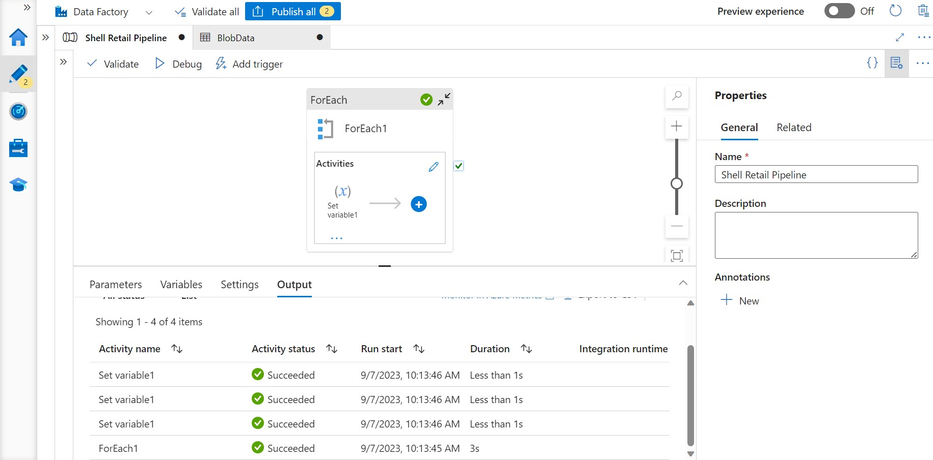
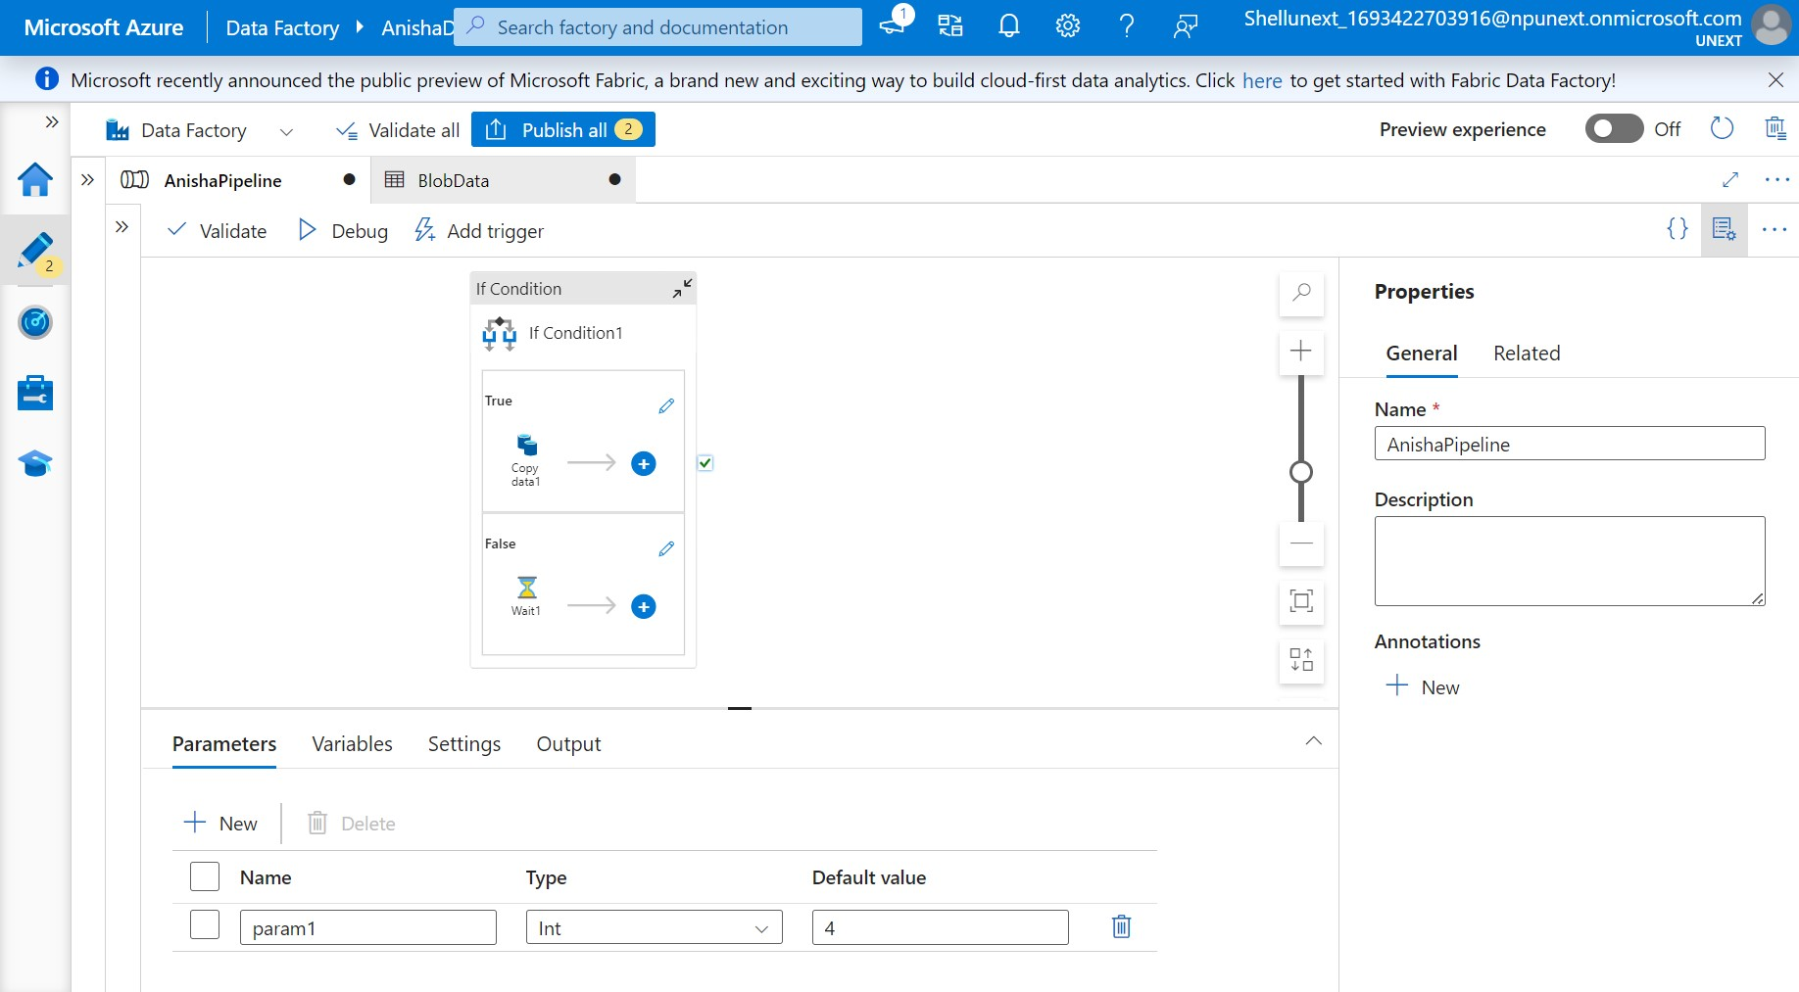
For each
If/wait/set variable/append variable

Slide 11
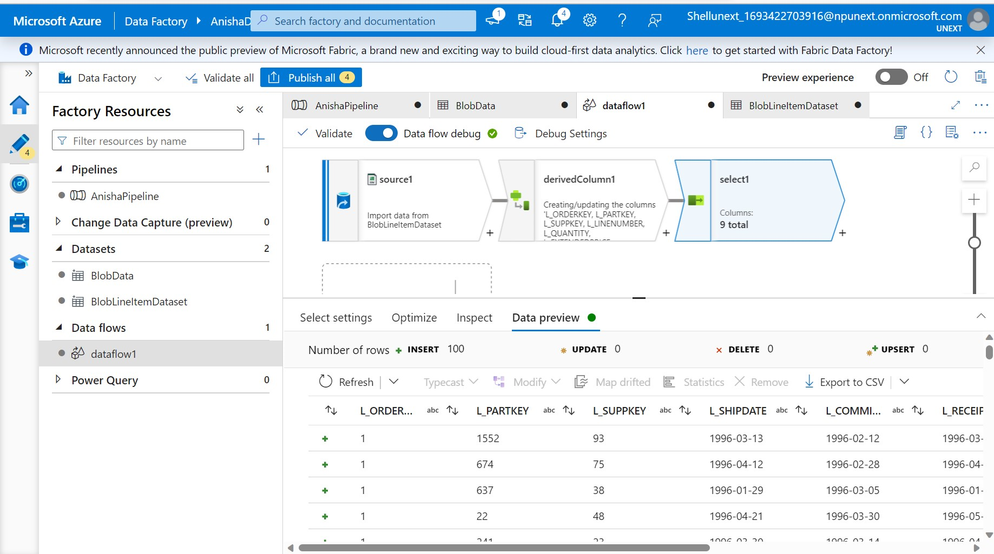
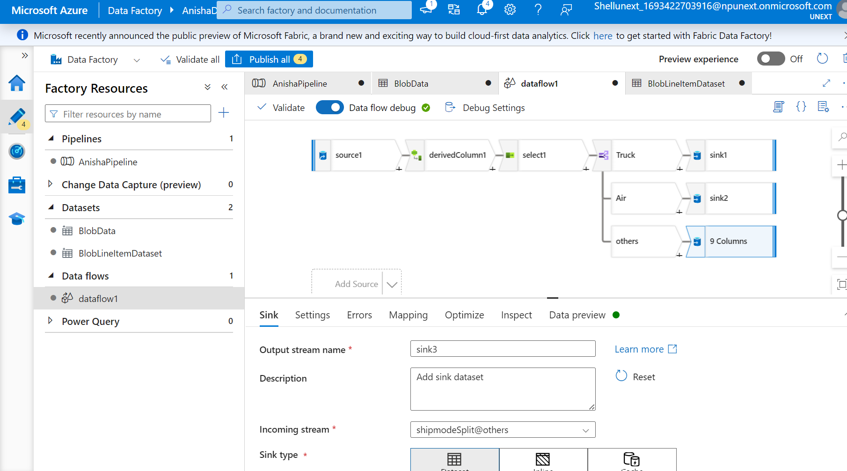
Derived Column
Select condition

Slide 12
DAY 9: 08-09-2023
Realtime scenarios –
Data Migration – From the existing files, heterogeneous sources migrate the data to homogeneous DW or data mart.
Intermediate Stage Layers – We perform data cleansing, scrubbing and other transformation on the data before loading into DW/DM.
Azure data migration from on premises to cloud DW.
Learnt and implemented Change data preview- to maintain primary key constraint

Slide 13
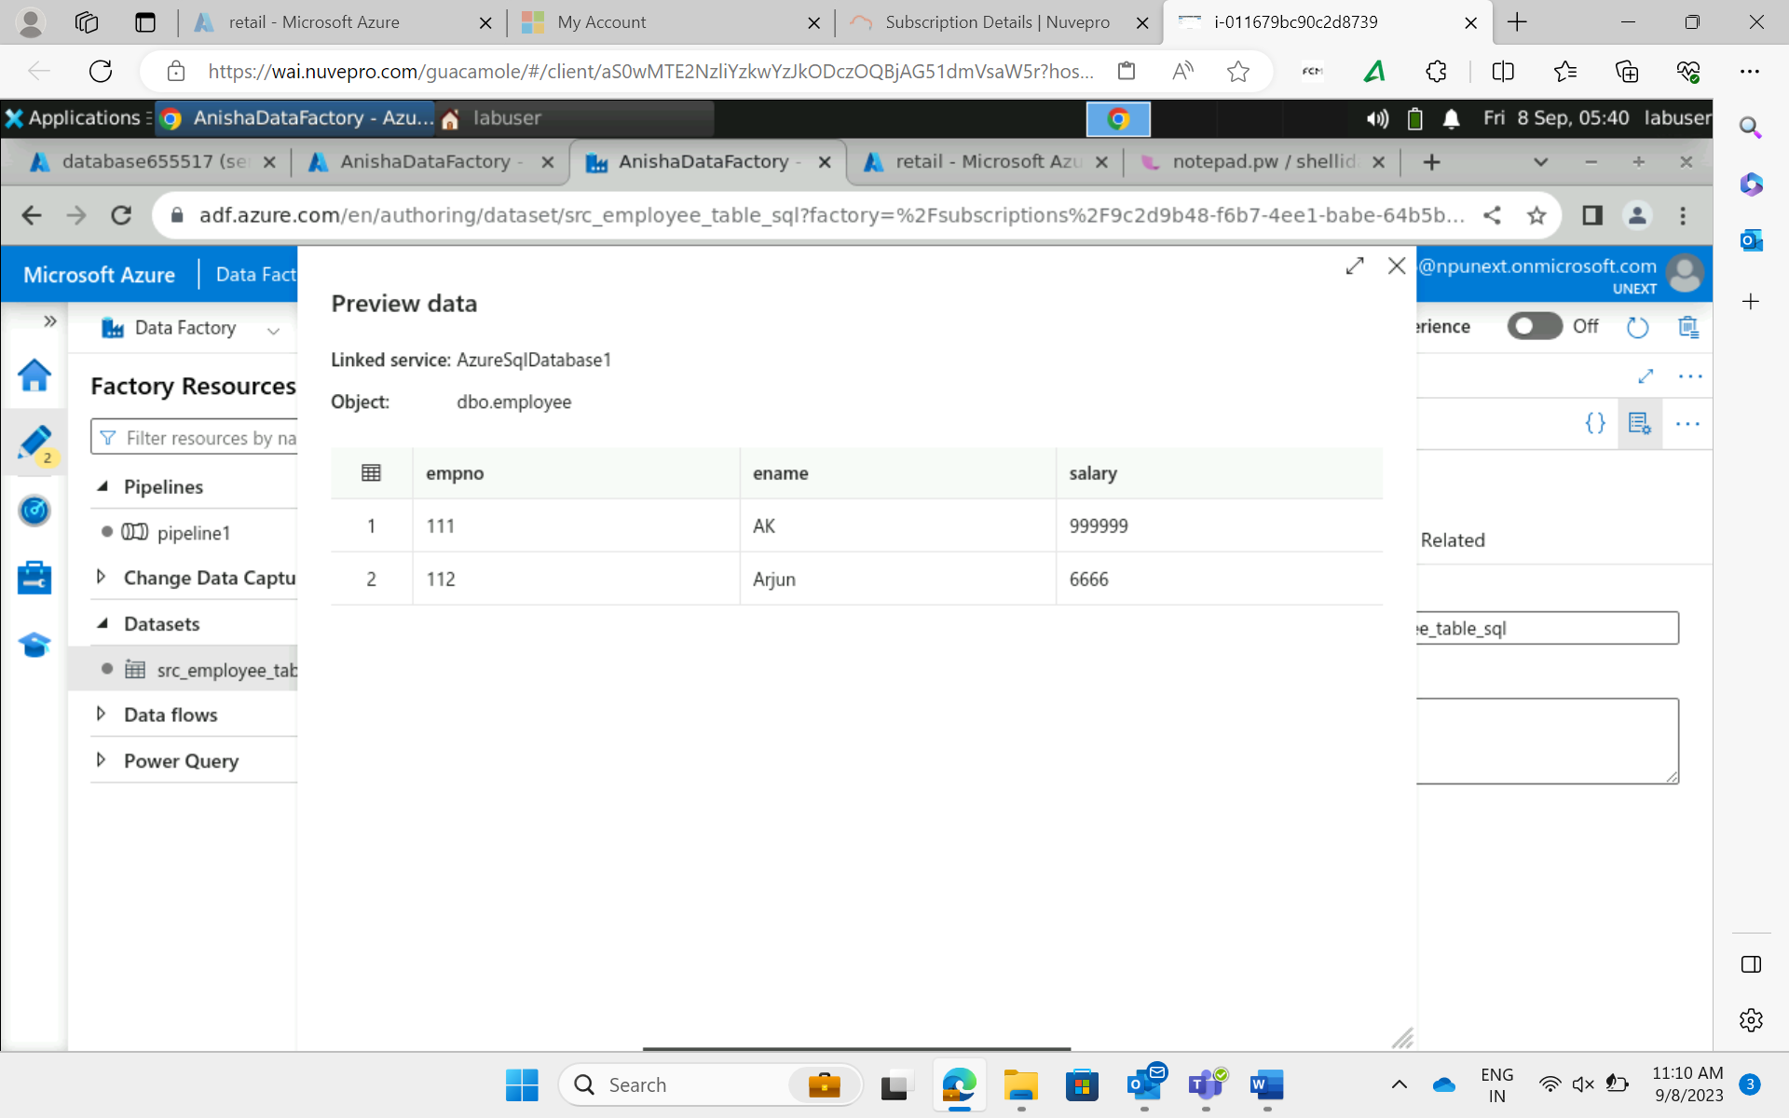
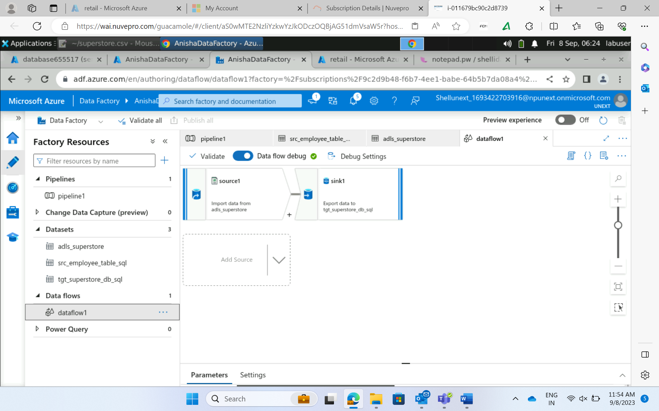
Viewing existing SQL data from AzureSQL in Data Factory
Data transfer from source to AzureSQL

Slide 14
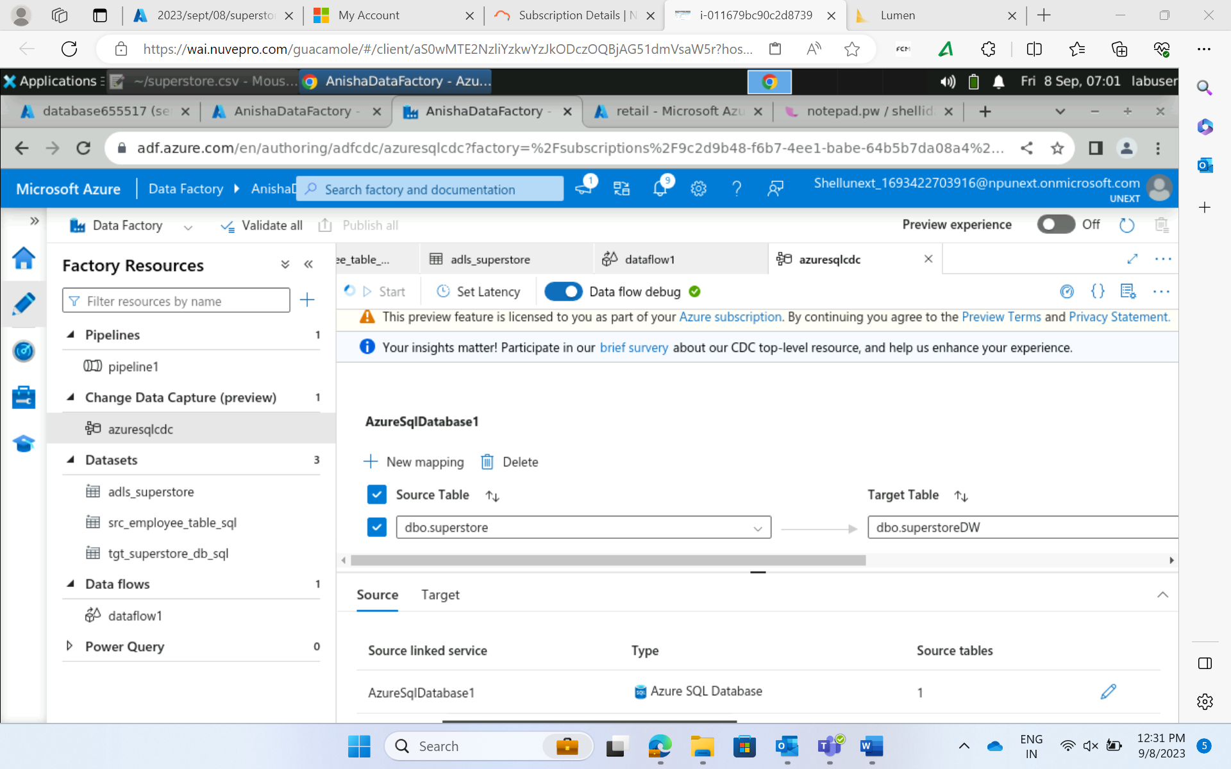
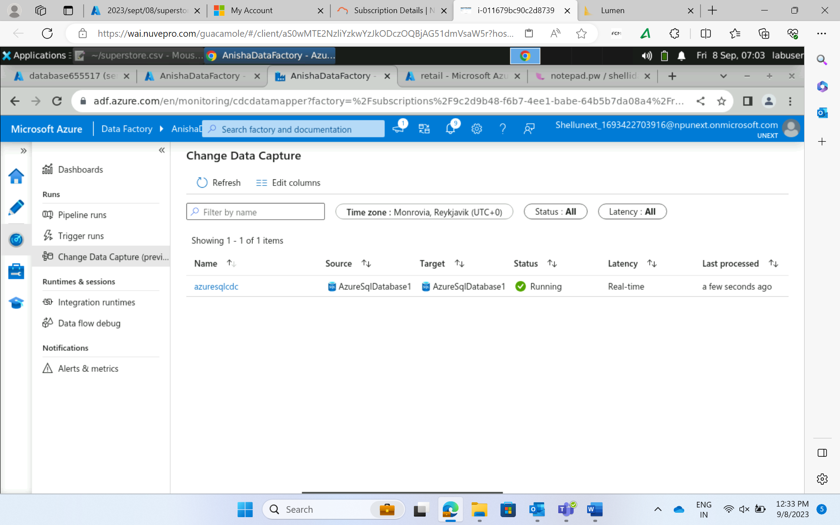
Change Data Capture

